Slide 1



Noida Institute of Engineering and Technology, Greater Noida
LAPLACE TRANSFORM
Unit: 4
Subject Name: Mathematical Foundation-II
Dr. Manoj Yadav
Department of Mathematics
B Tech -2nd Semester

Slide 2
Content
Introduction
Definition of Laplace Transform
Existence of Laplace Transform
Laplace Transform of Derivatives and Integrals
Initial Value and Final Value Theorem
Laplace of Periodic function
Unit step function and Dirac- delta function
Inverse Laplace transform
Convolution theorem
Application to solve simple linear and simultaneous differential equations

Slide 3
Course Objective
The objective of this course is to familiarize the engineering students with techniques of solving Ordinary Differential Equations, Fourier series expansion, Laplace Transform and vector calculus and its application in real world. It aims to equip the students with adequate knowledge of mathematics that will enable them in formulating problems and solving problems analytically.

Slide 4
Unit Objective
After studying this unit, student will be able to:
determine the Laplace transforms of derivatives of a function
obtain the Laplace transform of the integral of a function
calculate the inverse Laplace transform of the derivative and integral of a Laplace transform of some function
use Laplace transforms to solve an ordinary differential equation with given initial and boundary conditions.

Slide 5
Course Outcomes 2020-21 (B. Tech. – 2nd Sem)
Course Name: Mathematical Foundation-II
CO1 | Apply multiple integral to find area and volume.
CO2 | Apply the concept of differentiation to solve differential equations.
CO3 | Illustrate the solution of partial differential equation of second order.
CO4 | Apply the Laplace transform to solve ordinary differential equations
CO5 | Demonstrate the basic concept Proportion & Partnership, Problem of ages, Allegation & Mixture, Direction, Blood relation , Simple & Compound interest

Slide 6
POs
S.No | Program Outcomes (POs)
PO 1 | Engineering Knowledge
PO 2 | Problem Analysis
PO 3 | Design/Development of Solutions
PO 4 | Conduct Investigations of Complex Problems
PO 5 | Modern Tool Usage
PO 6 | The Engineer & Society
PO 7 | Environment and Sustainability
PO 8 | Ethics
PO 9 | Individual & Team Work
PO 10 | Communication
PO 11 | Project Management & Finance
PO 12 | Lifelong Learning
Nidhi Sharma KMB-104 Unit-1

Slide 7
CO-PO Mapping
CO | PO-1 | PO-2 | PO-3 | PO-4 | PO-5 | PO-6 | PO-7 | PO-8 | PO-9 | PO-10 | PO-11 | PO-12
CO1 | 3 | 3 | 3 | 3 | 3 | 1 | 2 | - | - | 2 | 2 | 3
CO2 | 3 | 3 | 3 | 2 | 2 | - | - | - | - | 2 | 2 | 1
CO3 | 3 | 2 | 3 | 2 | 3 | 1 | - | - | - | 2 | 2 | 2
CO4 | 3 | 2 | 3 | 2 | 3 | 1 | 1 | - | - | 2 | - | 3
CO5 | 1 | 1 | 1 | 1 | 1 | - | - | - | - | 2 | - | 2
Mean | 2.6 | 2.2 | 2.6 | 2 | 2.4 | 1.0 | 1.5 | - | - | 2 | 2 | 2.2

Slide 8
Prerequisite and Recap
Differentiation
Integration
Partial Fraction
Solution of Ordinary Differential Equations

Slide 9
Topic Objective
After studying this topic, student will be able to:
determine the Laplace transforms of Elementary functions .

Slide 10
Laplace Transform (co4)
One of the important tools applied in numerous areas such as Circuit Analysis, Control Systems, Communication System, Signal Processing, Mechanics, Hydrodynamics, Heat Conduction, Beam Problems, Networks and Space Theory is Laplace Transformation. In this Unit, the techniques and applications of Laplace Transformations are discussed. Using Laplace transforms, the differential equation is converted to an algebraic equation which can be solved easily. The inverse Laplace transform of this solution gives the solution of the differential equation.

Slide 11
Laplace Transform (co4)
Definition:
Let F(t) be a function of t defined for all positive values of t. then the Laplace Transform of F(t) is defined as
provided that the integral exists, s is a parameter which may be a real or a complex number.
clearly is a function of s, which can be written as
Also F(t) is called Inverse Laplace Transform of and is denoted by

Slide 12
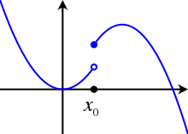
PIECEWISE CONTINUOUS FUNCTIONS (co4)
DEFINITION
function F(t) is said to be piecewise (sectionally) continuous on a closed interval [a,b] if it is defined on that interval and is such that the interval can be subdivided into a finite no. of subintervals, in each of which F(t) is continuous and has finite right and left hand limits.

Slide 13
FUNCTIONS OF EXPONENTIAL ORDER (co4)
DEFINITION
A function F(t) is of exponential order if there exists a positive constant M, a no. And a finite number and such that
If a function F(t) is of exponential order then F(t) is also of exponential order where .

Slide 14
FUNCTION OF CLASS A (co4)
Definition-
A function which is piecewise continuous on every finite interval in the range t and is of exponential order as t is known as FUNCTION OF CLASS A.

Slide 15
EXISTENCE OF LAPLACE TRANSFORM (co4)
SUFFICIENT CONDITIONS FOR EXISTENCE THEOREM OF LAPLACE TRANSFORM
Statement- If F(t) is of class A i.e. F(t) is piecewise continuous and is of exponential order then L[f(t)], the Laplace Transform of F (t) exists for s greater than .

Slide 16
Laplace Transform of elementary functions (co4)

Slide 17
Laplace Transform of elementary functions (co4)

Slide 18
Example
Find the Laplace transform of the following functions

Slide 19
Example
Find the Laplace transform of the following functions

Slide 20
FAQ
Find the Laplace transform of the following functions

Slide 21
Daily Quiz

Slide 22
Recap
Existence of Laplace transform.
Laplace Transform Of Elementary Functions.

Slide 23
Properties of LAPLACE TRANSFORM (co4)
1.Linearity property
2.First Shifting property
3.Change of scale property

Slide 24
1.Linearity Property:(co4)
Statement:

Slide 25
2.FIRST SHIFTING PROPERTY: (co4)
Statement:

Slide 26
3. Change of scale property: (co4)
Statement:

Slide 27
Example
Find the Laplace transform of the following function

Slide 28
FAQ
Find the Laplace transform of the following functions

Slide 29
Daily Quiz

Slide 30
Recap
Laplace Transform Of Elementary Functions
Properties of Laplace Transform

Slide 31
Topic Objective
After studying this topic, student will be able to:
determine the Laplace transforms of derivatives of a function
obtain the Laplace transform of the integral of a function

Slide 32
Laplace Transform of derivatives (co4)
Statement:

Slide 33
Example

Slide 34
Laplace Transform of integral (co4)
Statement-

Slide 35
Example

Slide 36
Laplace Transform of (co4)

Slide 37
Example

Slide 38
Laplace Transform of (co4)

Slide 39
Example

Slide 40
FAQ
Find the Laplace transform of the following functions

Slide 41
Daily Quiz

Slide 42
Recap
Laplace Of Derivatives
Laplace of Integrals
Laplace of t.f(t)
Laplace of f(t)/t

Slide 43
Example

Slide 44
Initial and Final Value Theorem (co4)
Initial value theorem
Statement-
then
Final value theorem
Statement-
then

Slide 45
Topic Objective
After studying this topic, student will be able to:
determine the Laplace transforms of Periodic function .
obtain the Laplace transform of Unit impulse function and Dirac Delta Function.

Slide 46
Laplace Transform of Periodic Function

Slide 47
Example

Slide 48
Example

Slide 49
UNIT STEP FUNCTION (co4)
(HEAVISIDE’S UNIT STEP FUNCTION)
The unit step function denoted by u(t-a) or H(t-a) is defined by
u(t)
1
t
u(t-a)
1
.
a
t

Slide 50
Continued

Slide 51
Important Results (co4)

Slide 52
Example

Slide 53
Example

Slide 54
Example

Slide 55
Example
F(t)
.
1
.
.
1
2
t

Slide 56
Continued

Slide 57
DIRAC DELTA FUNCTION or IMPULSE FUNCTION (co4)
When a large force acts for a short time, then the product of the force and the time is called impulse in applied mechanics. The unit impulse function is the limiting function.

Slide 58
Continued
F(t)
t
O
t=a
t=a+

Slide 59
Example

Slide 60
Continued

Slide 61
FAQ

Slide 62
Faculty Video Links, Youtube & NPTEL Video Links and Online Courses Details
Self Made Video Link:
https://youtu.be/nmp-5tSp-UY
https://youtu.be/6ANT4eD6fII
Youtube/other Video Links
https://youtu.be/c9NibpoQjDk
https://www.youtube.com/playlist?list=PLNOGlXC4kCBT8G5pWCrH71hmwaAvwsBY3

Slide 63
Daily Quiz

Slide 64
Recap
Laplace Of Periodic Functions
Laplace of Unit Step Function
Laplace of Dirac Delta Function
Discussion on Assignment

Slide 65
Weekly Assignment

Slide 66
Weekly Assignment

Slide 67
Inverse Laplace Transform (co4)

Slide 68
Inverse Laplace Transform of Elementary Functions (co4)

Slide 69
Continued

Slide 70
First Shifting Property (co4)

Slide 71
Second Shifting Property (co4)

Slide 72
Example

Slide 73
Example

Slide 74
Example

Slide 75
Multiplication By s (co4)

Slide 76
Example

Slide 77
Daily Quiz

Slide 78
Recap
Inverse Laplace Transform
Second Shifting Property

Slide 79
Division By s (co4)

Slide 80
Example

Slide 81
Topic Objective
After studying this topic, student will be able to:
calculate the inverse Laplace transform of the derivative and integral of a Laplace transform of some function

Slide 82
Inverse Laplace Transform of Derivatives (co4)

Slide 83
Example

Slide 84
Inverse Laplace Transform of Integrals (co4)

Slide 85
Partial Fractions Method (co4)

Slide 86
FAQ

Slide 87
Daily Quiz

Slide 88
Recap
Inverse Laplace Transform of Derivatives
Inverse Laplace Transform of Integrals
Inverse Laplace Transform by Partial Fraction method

Slide 89
Convolution Theorem (co4)

Slide 90
Example

Slide 91
Continued

Slide 92
Continued

Slide 93
Topic Objective
After studying this topic, student will be able to:
use Laplace transforms to solve an ordinary differential equation with given initial and boundary conditions.

Slide 94
Solution of Differential Equation by L. T.(co4)

Slide 95
Continued

Slide 96
Solution of Simultaneous D. E. by L. T.(co4)

Slide 97
Continued

Slide 98
FAQ

Slide 99
FAQ

Slide 100
Faculty Video Links, Youtube & NPTEL Video Links and Online Courses Details
Self Made Video Link:
https://youtu.be/nmp-5tSp-UY
https://youtu.be/6ANT4eD6fII
Youtube/other Video Links
https://youtu.be/c9NibpoQjDk
https://www.youtube.com/playlist?list=PLNOGlXC4kCBT8G5pWCrH71hmwaAvwsBY3

Slide 101
Daily Quiz

Slide 102
Recap
Convolution Theorem
Solution of Differential Equation by Laplace Transform
Solution of Simulteneous Differential Equation by Laplace Transform

Slide 103
Weekly Assignment

Slide 104
Weekly Assignment

Slide 105
Weekly Assignment

Slide 106
MCQ s

Slide 107
MCQ s

Slide 108
MCQ s

Slide 109
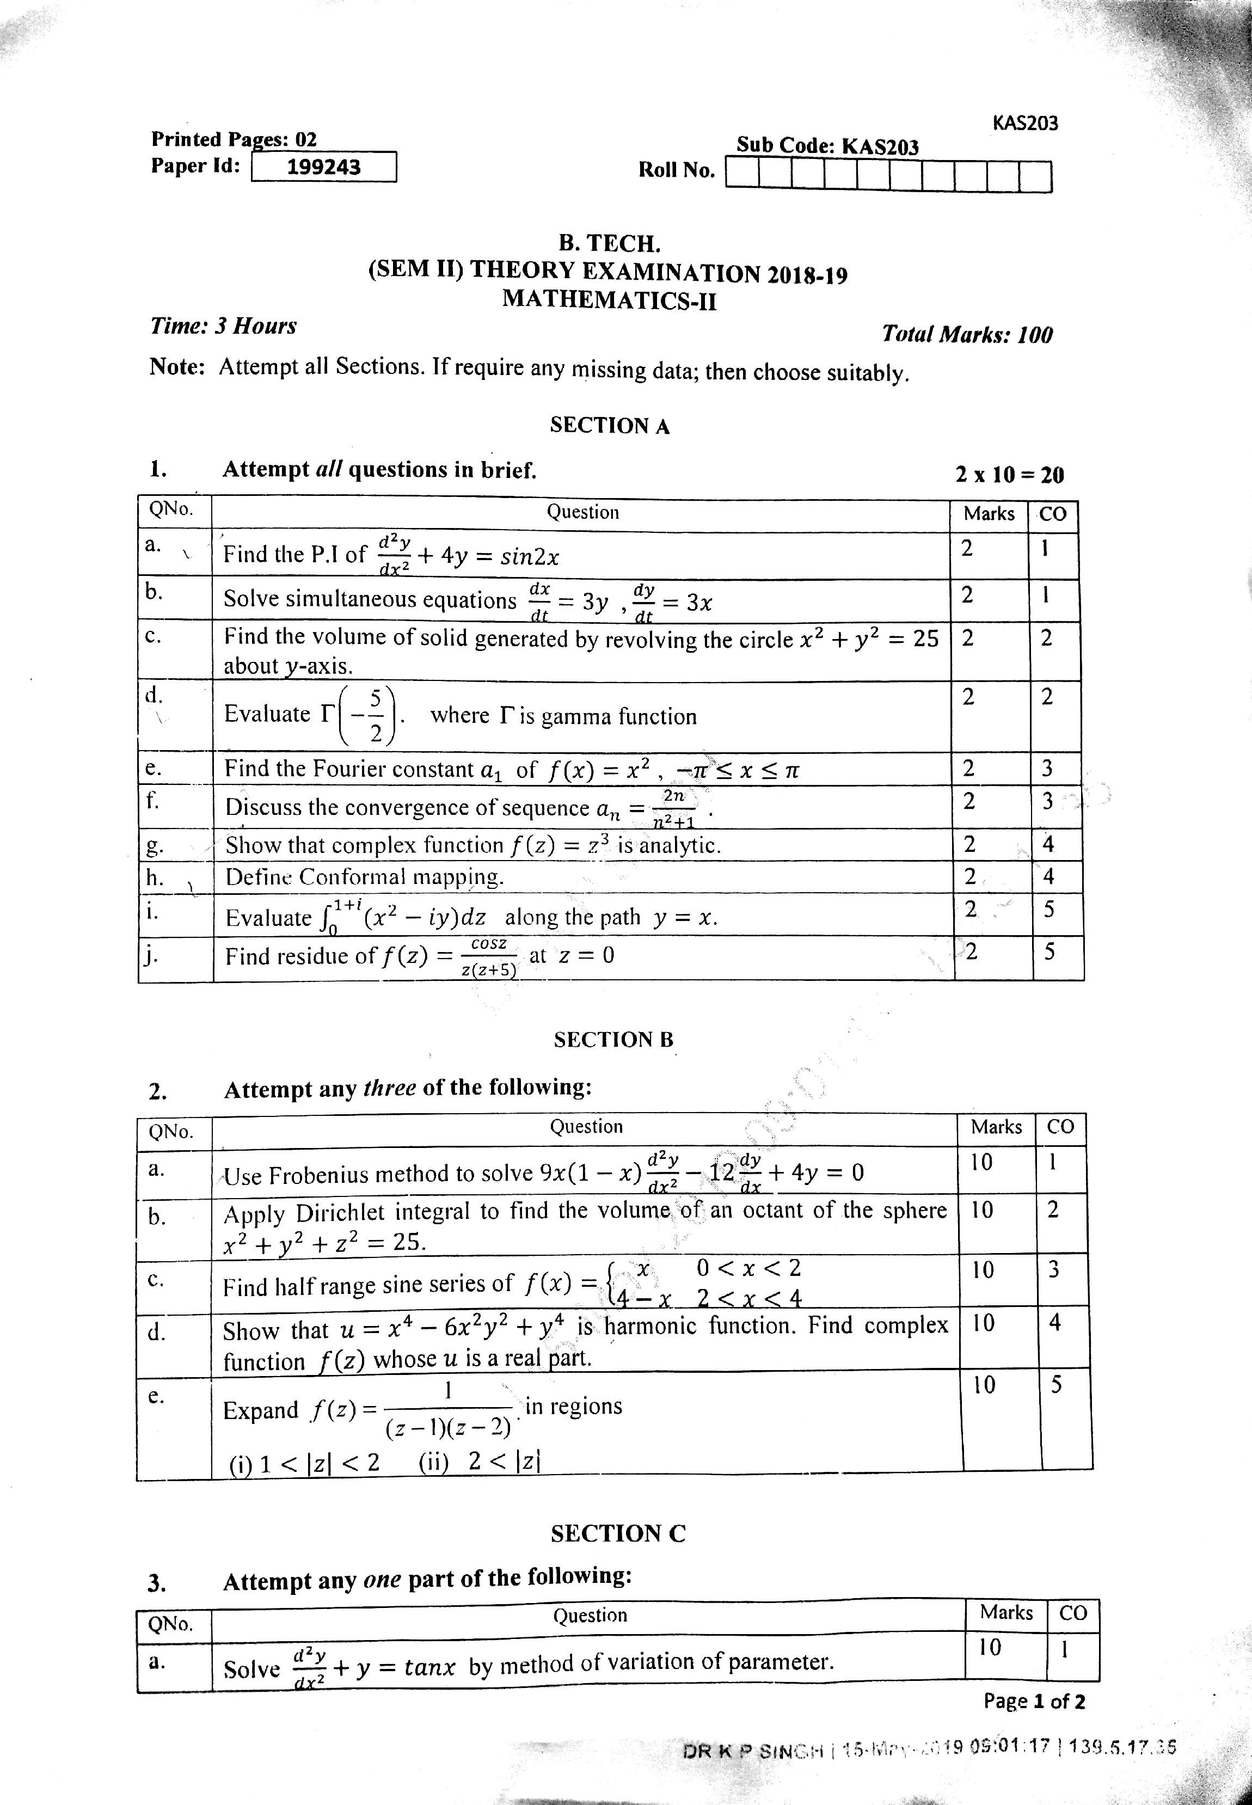
Old Question Papers

Slide 110
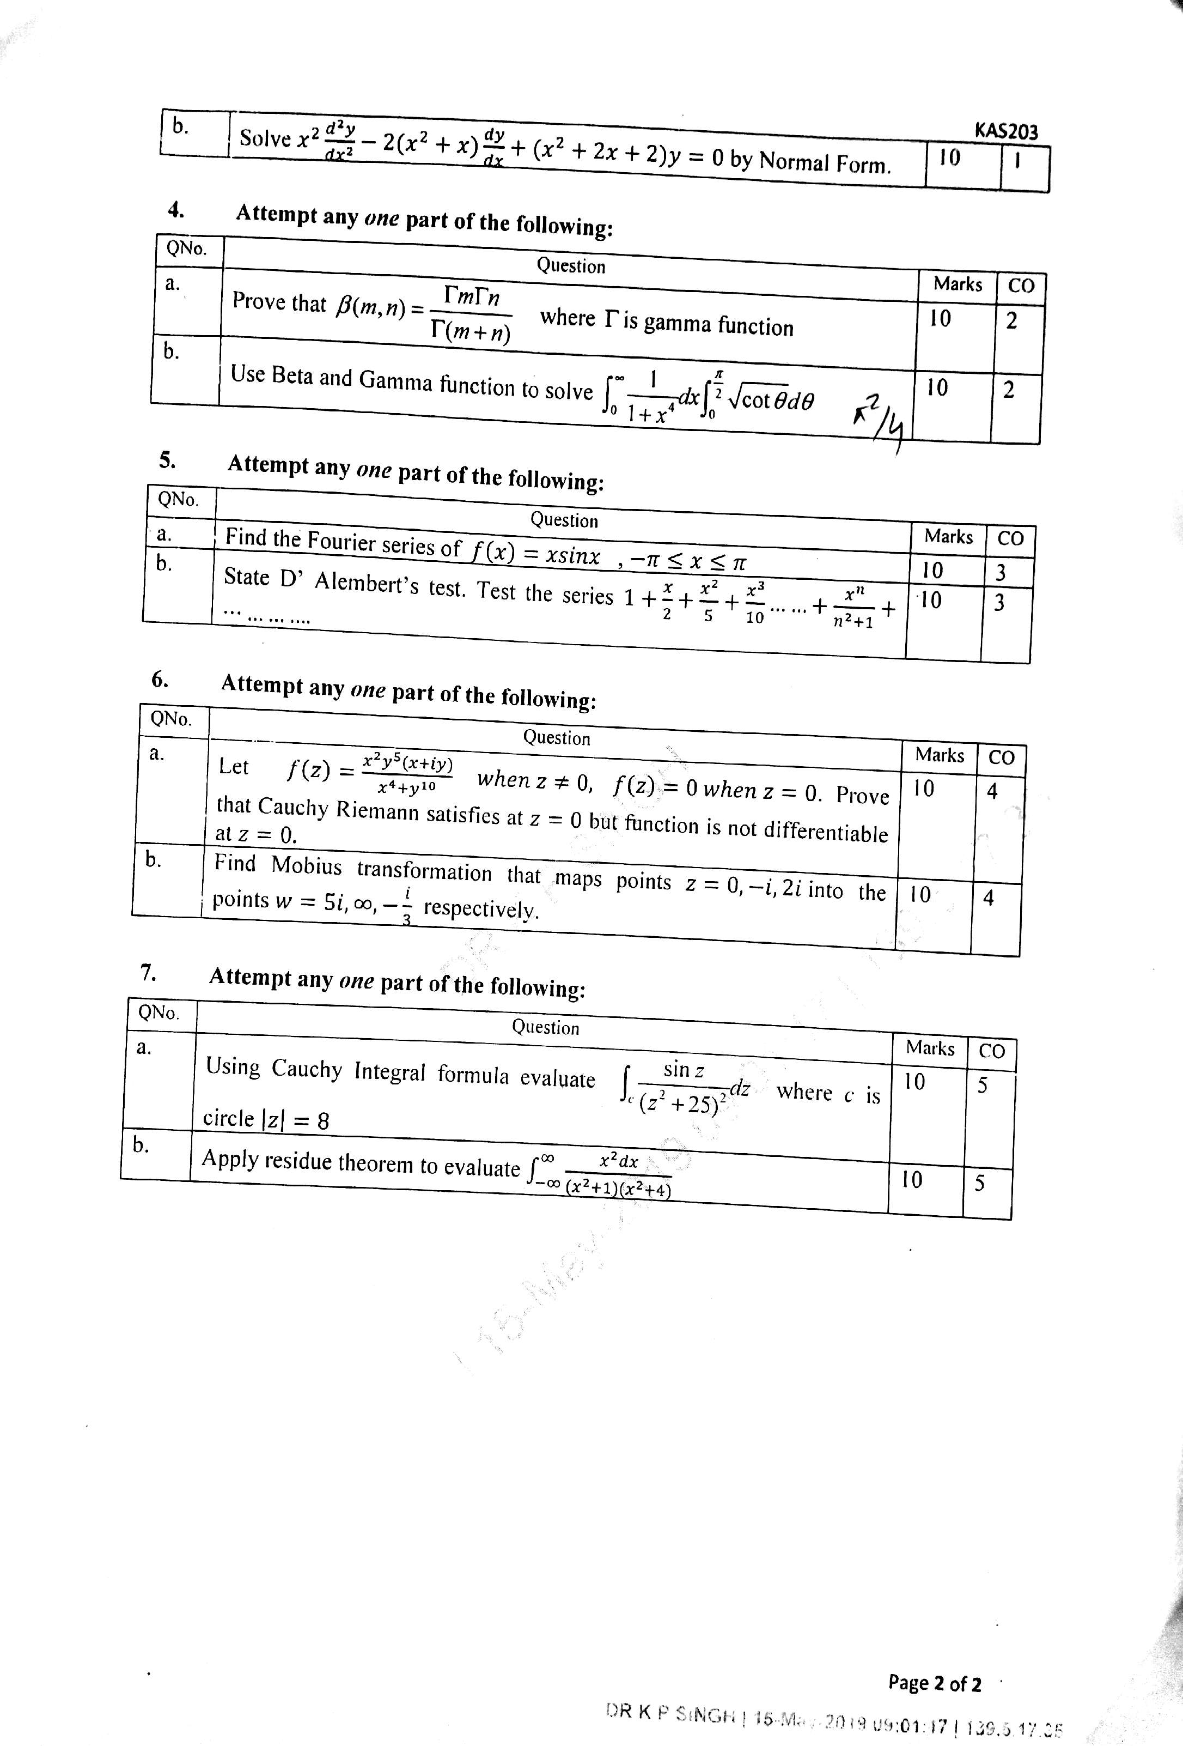
Old Question Papers

Slide 111
Expected Questions for University Exam

Slide 112
Expected Questions for University Exam

Slide 113
Expected Questions for University Exam

Slide 114
Expected Questions for University Exam

Slide 115
Summary
.
Laplace transforms help in solving the differential equations with boundary values without finding the general solution and the arbitrary constants.

Slide 116
References
E. Kreyszig, Advanced Engineering Mathematics,
John Wiley & Sons.
B. V. Ramana, Higher Engineering Mathematics,
Tata Mc Graw- Hill Publishing Company Ltd.
R.K.Jain & S.R.K. Iyenger, Advance Engineering Mathematics,
Narosa Publishing House.
B.S. Grewal, Higher Engineering Mathematics,
Khanna Publishers.
Peter V. O’ Neil, Advanced Engineering Mathematics,
Thomas (Cengage) Learning.

Slide 117
Thank You

